Slide 1









Hypothesis for EDA
Older
Smoke
Higher BMI
Lower test result
Treatments
Size of cancer
The higher chances of cancer
Increase survival rate
different survival rate

Slide 2


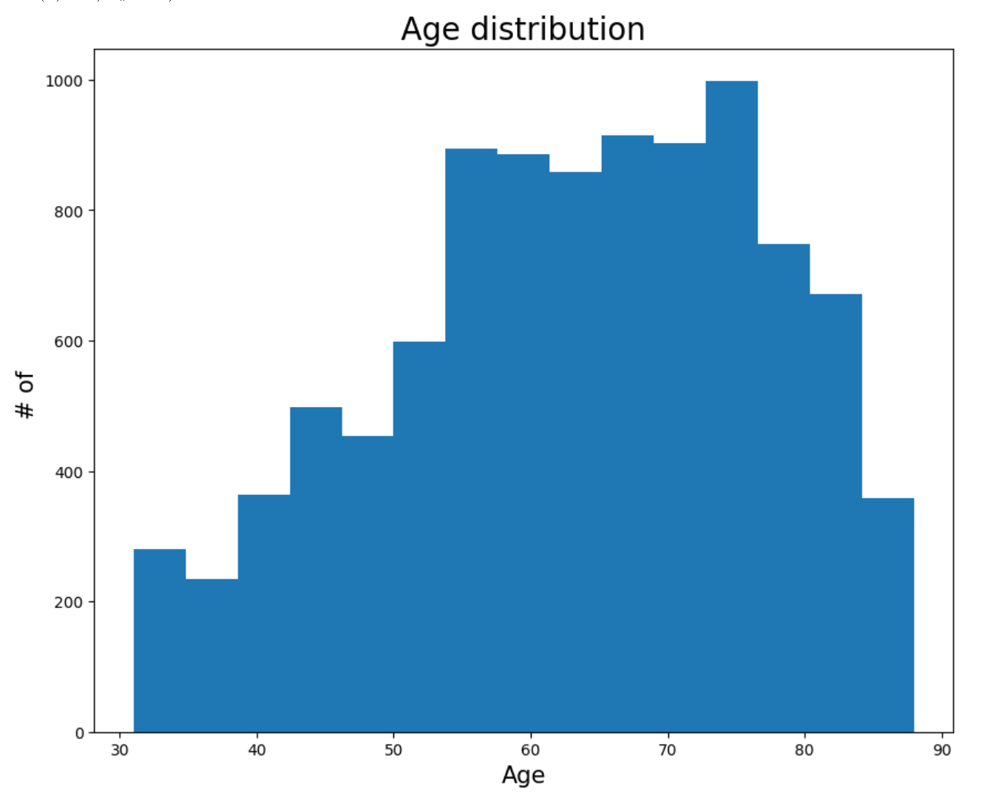

AGE
Histogram of the age distribution of cancer => More distributed in the older age
=> Age may be related to lung cancer

Slide 3
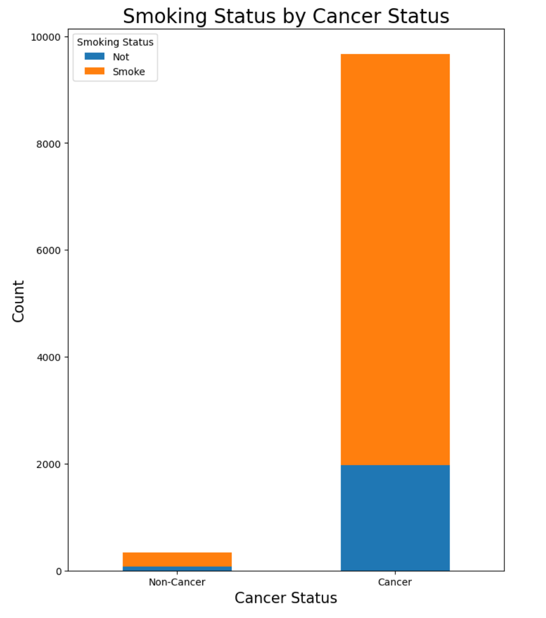
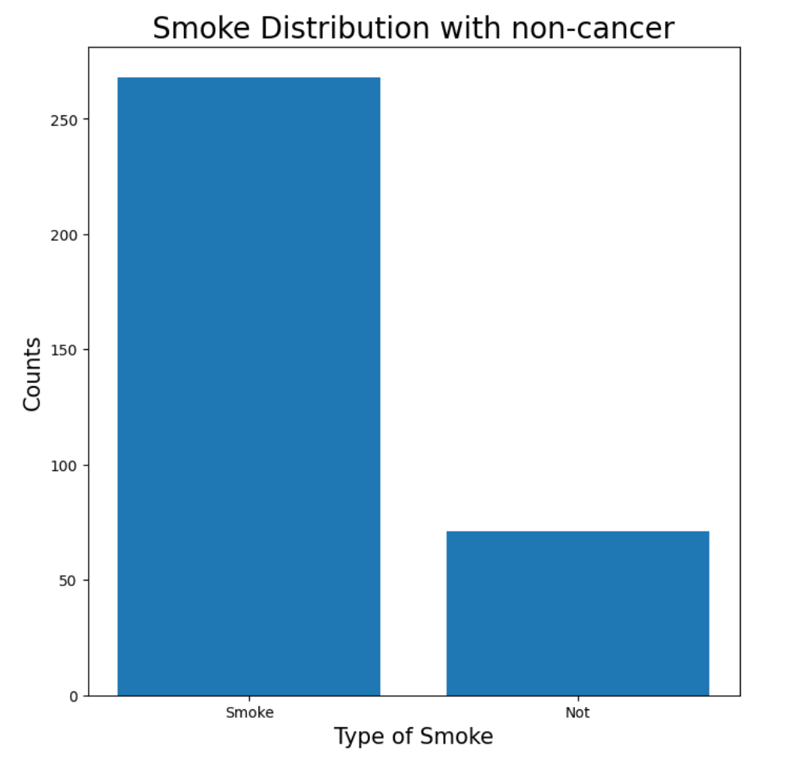

Smoking
smo
k
e
past smoking*
smoking
smo
k
e
current smoking
non-smoking
non-smoking
*Williamson, T.J. et al. (2020) ‘Lung cancer stigma: Does smoking history matter?’, Annals of Behavioral Medicine, 54(7), pp. 535–540. doi:10.1093/abm/kaz063.

Slide 4

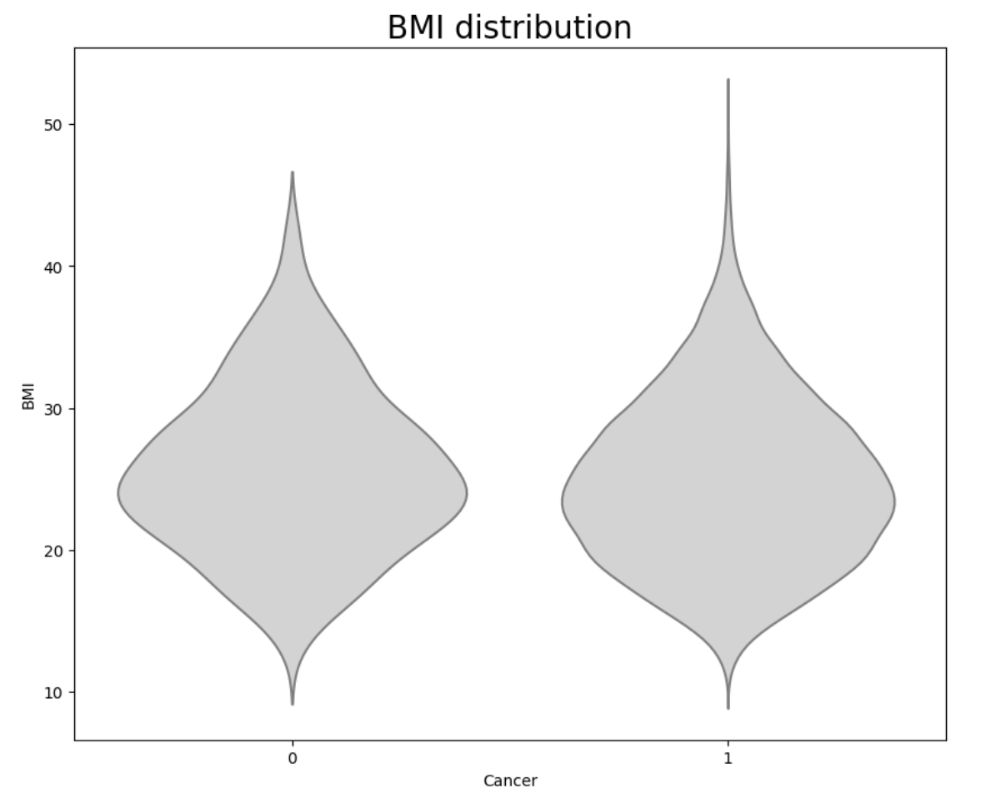
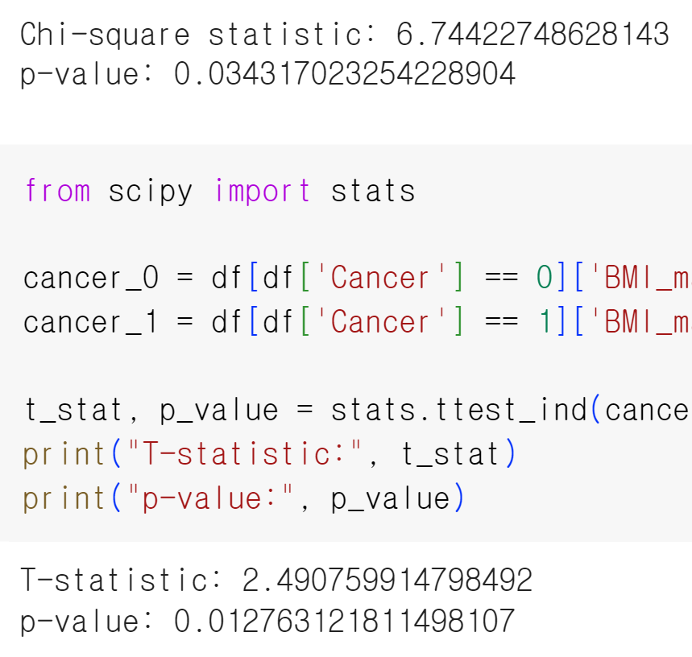

BMI
Chi-square test : p < .05
=> relationship between cancer and BMI
Independent t-test : p < .05
=> meaningful difference between two groups
non-cancer
cancer
Violin Plot : Hard to know relationship

Slide 5

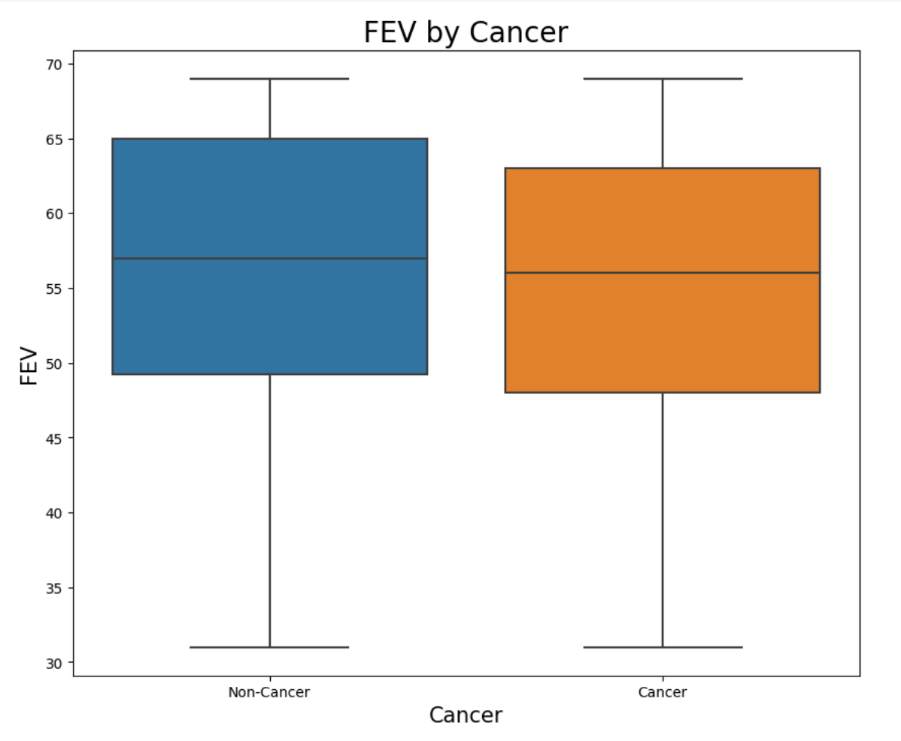
FEV test : indicator of bronchial obstruction
Normal range : 70% - 80%
Below 70% : problem with breathing
Entire : hard to say having relationship
Given: considering data only less than 70%
=> cancer data is lowly distributed
=> more likely to have cancer if under 70%

Slide 6
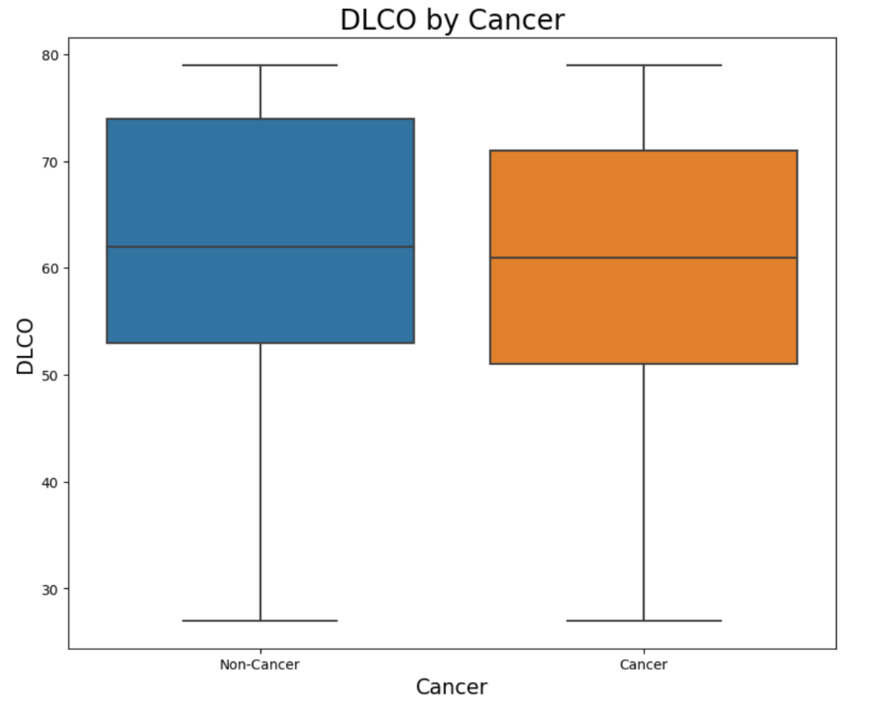
DLCO test : indicator of gas exchange
Normal range : 80 - 120
Below 80 : problem with breathing
Entire : hard to say having relationship
Given: considering data only less than 80
=> cancer data is lowly distributed
=> more likely to have cancer if under 80

Slide 7
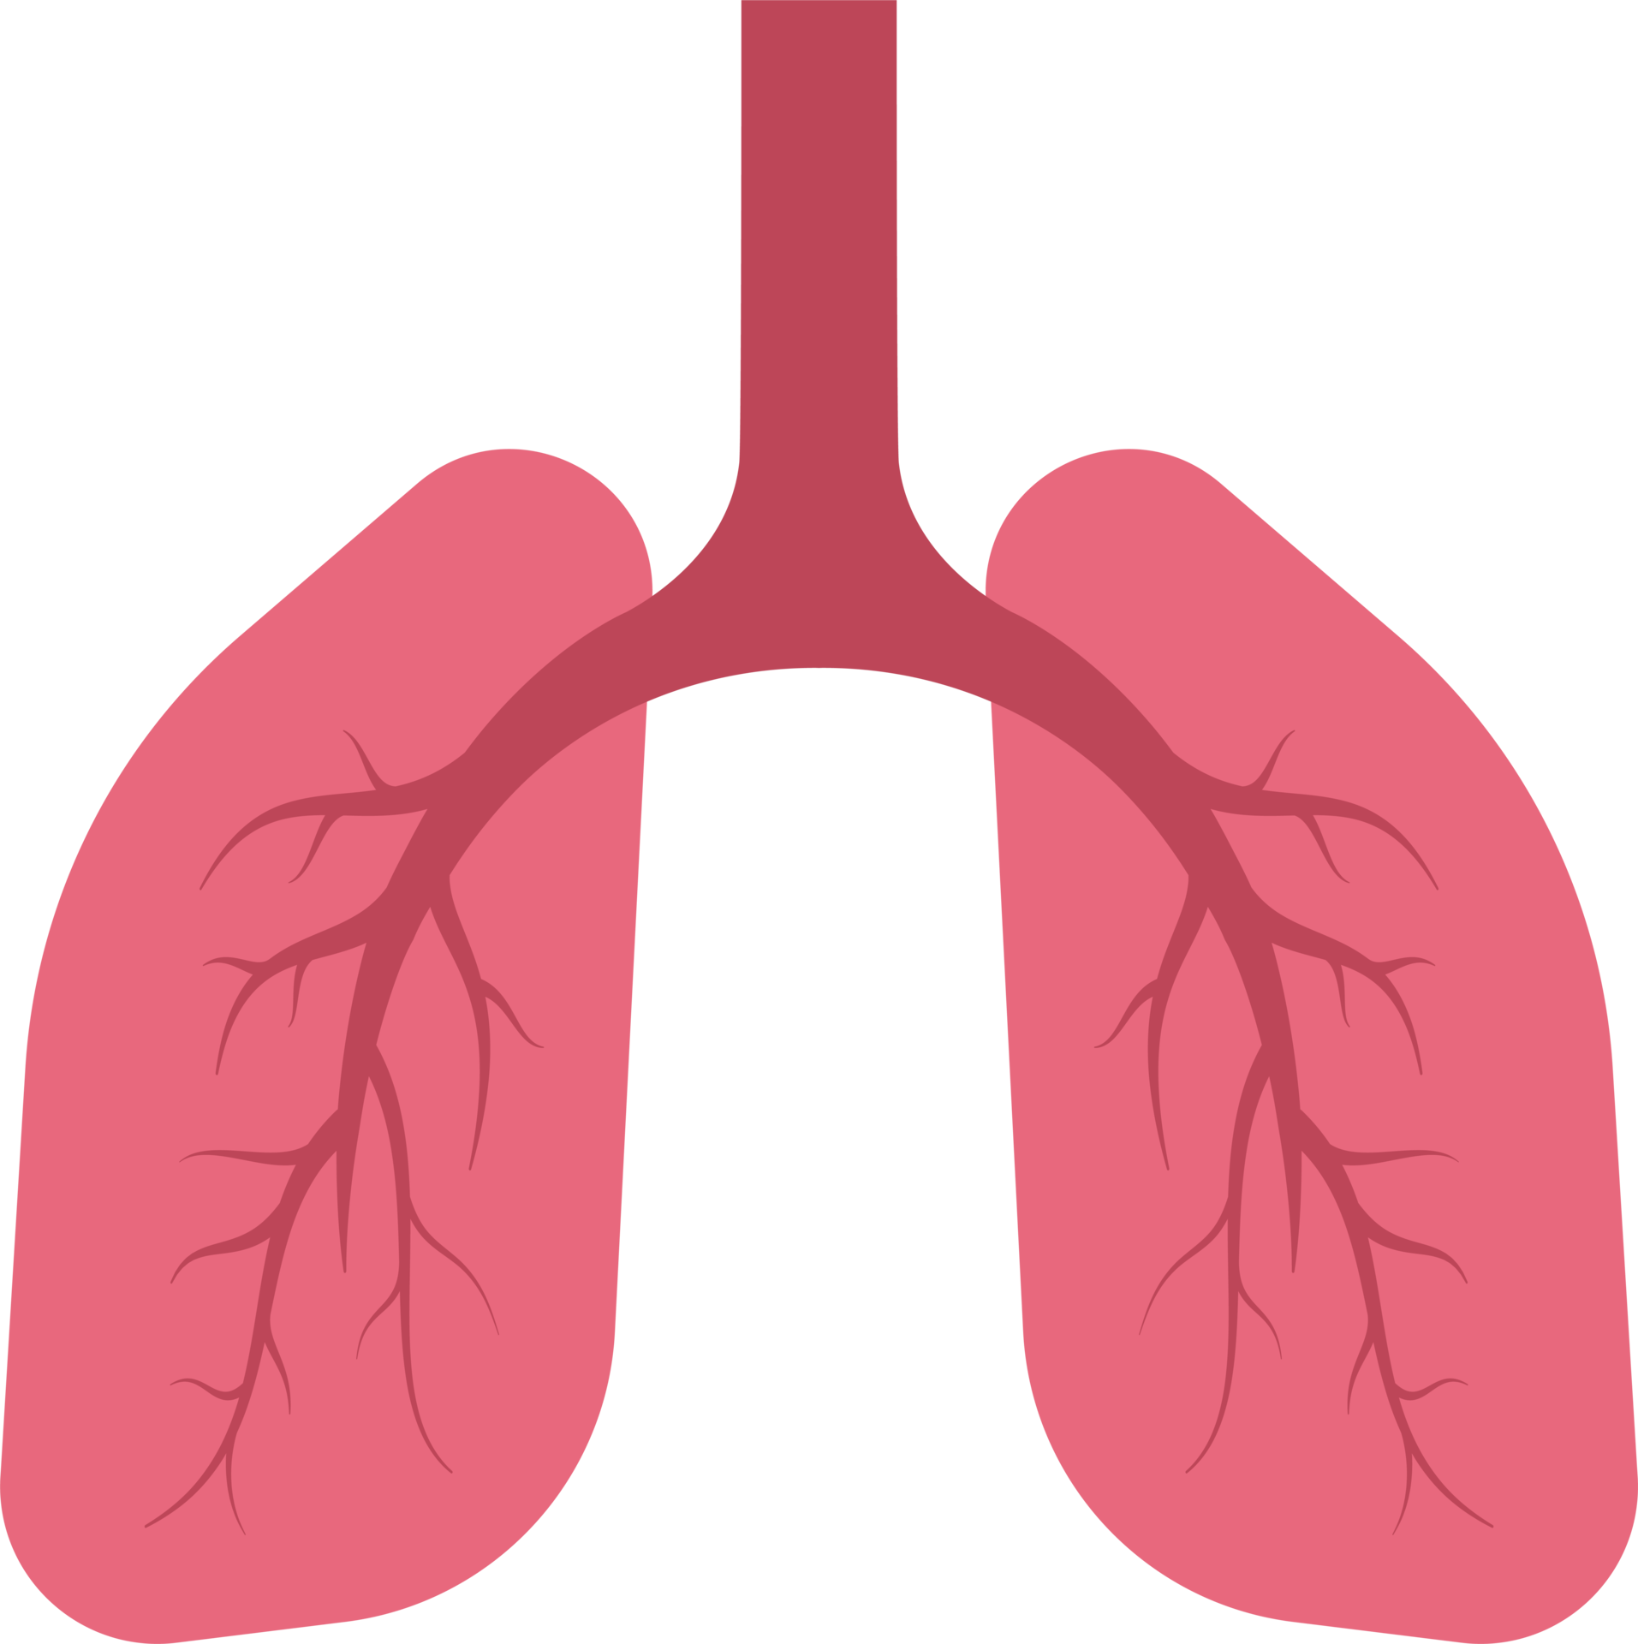
Classification Step
Lung Cancer?
Yes
No
Small or Non-Small?
Normal
Non-small
Small

Slide 8
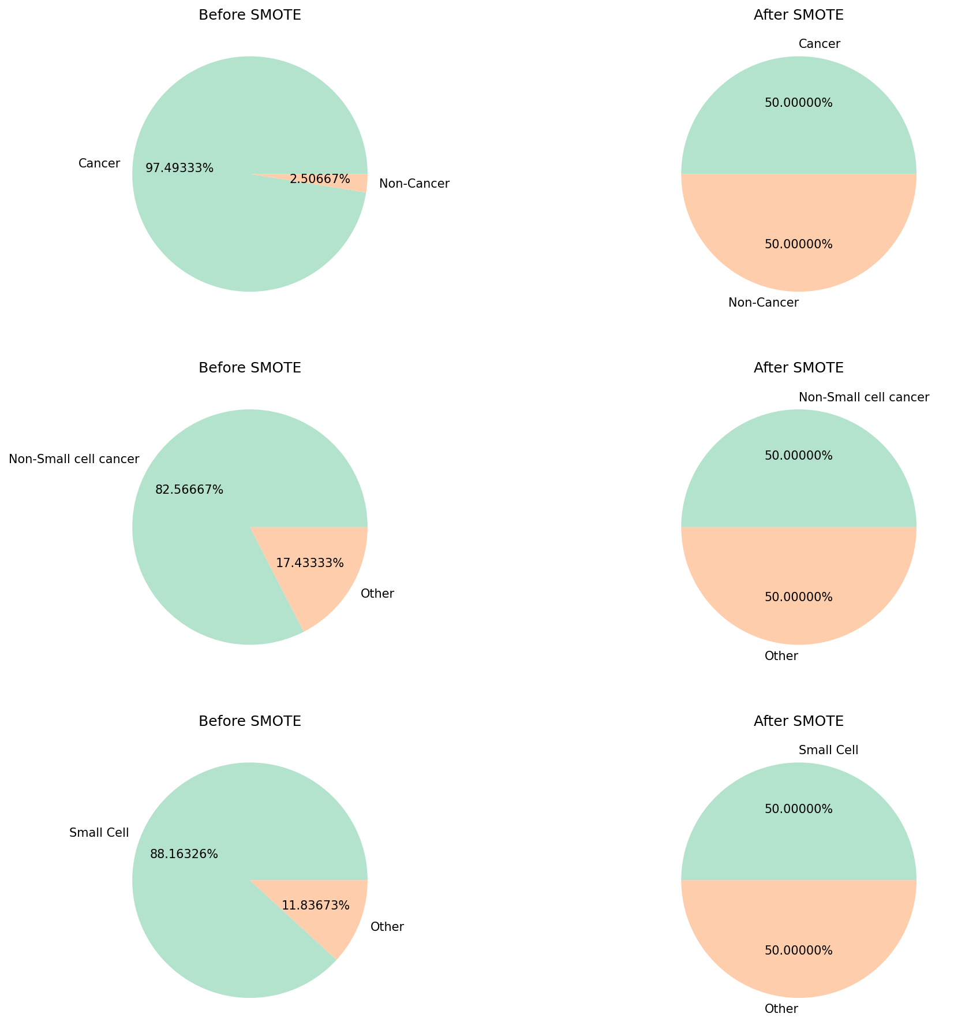
Preprocessing; SMOTE

Slide 9

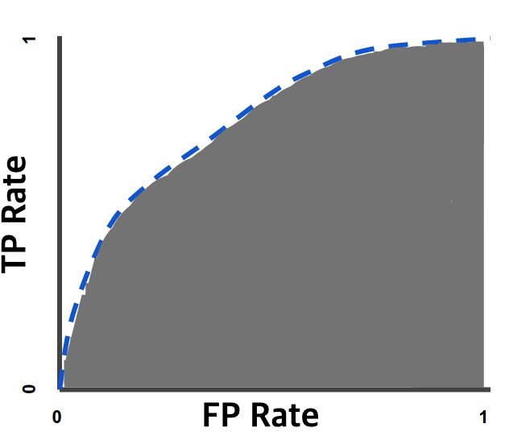



Evaluation; 5-fold Cross validation
Metrics; Accuracy, AUC, F1-Score

Slide 10
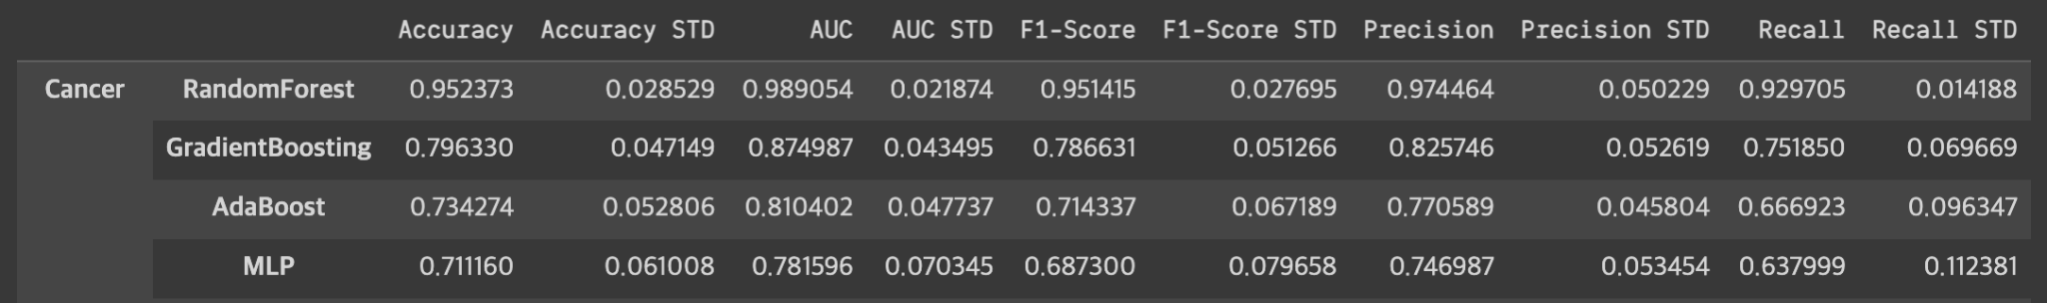
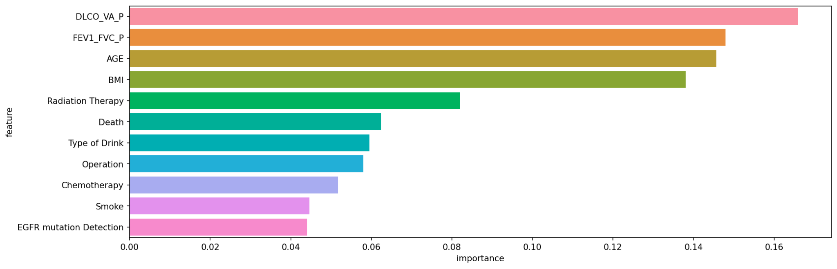
Classifying; Cancer or not
Random Forest
Accuracy : 0.95 +/- 0.02
AUC : 0.98 +/- 0.02
F1-Score : 0.95 +/- 0.03
DLCO > FEV > AGE > BMI > … > Smoke

Slide 11
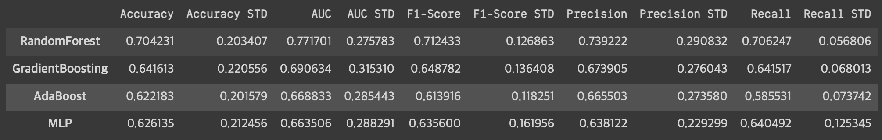
Classifying; Non-small or Small
Random Forest
Accuracy : 0.70 +/- 0.2
AUC : 0.77 +/- 0.27
F1-Score : 0.71 +/- 0.12

Slide 12

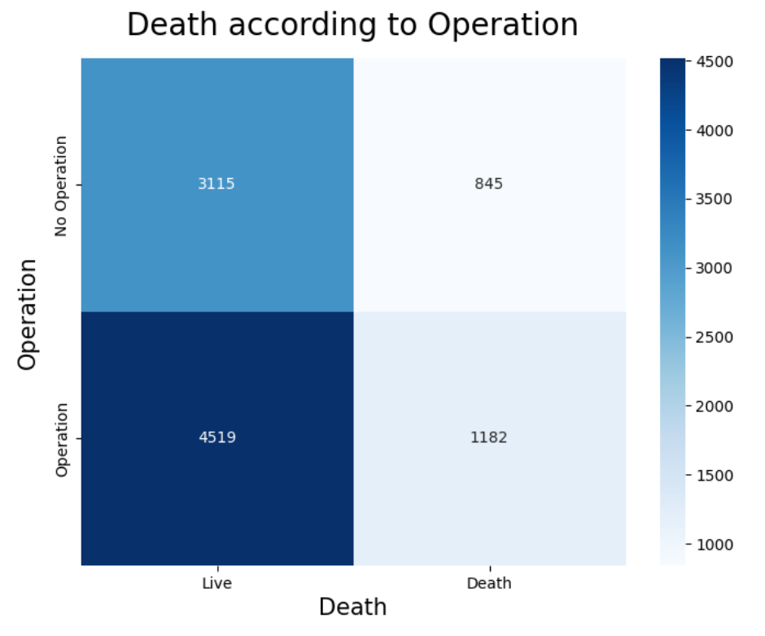
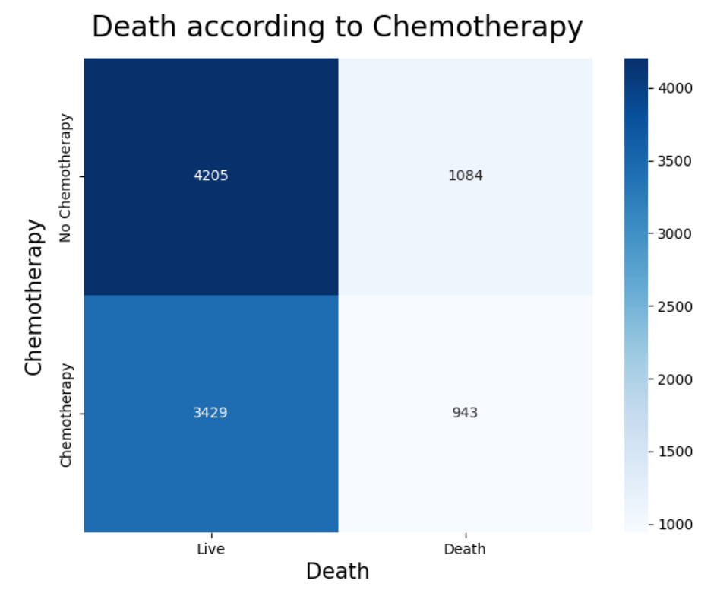
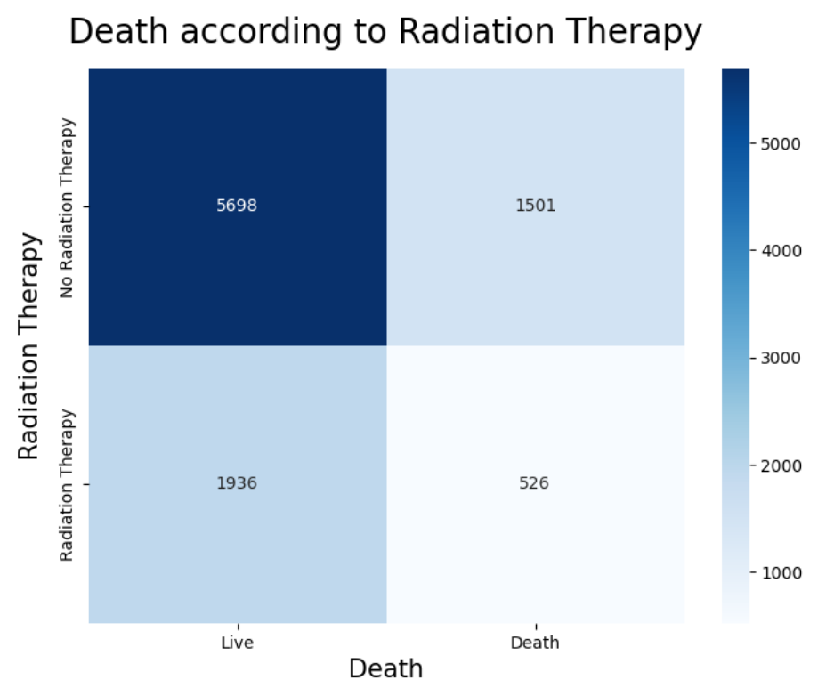

Treatments
s = survive
p(s | operation) = 0.792
p(s | operation^{C}) = 0.786
p(s | chemotherapy) = 0.785
p(s | chemotherapy^{C}) = 0.795
p(s | radiation) = 0.881
p(s | radiation^{C}) = 0.791

Slide 13

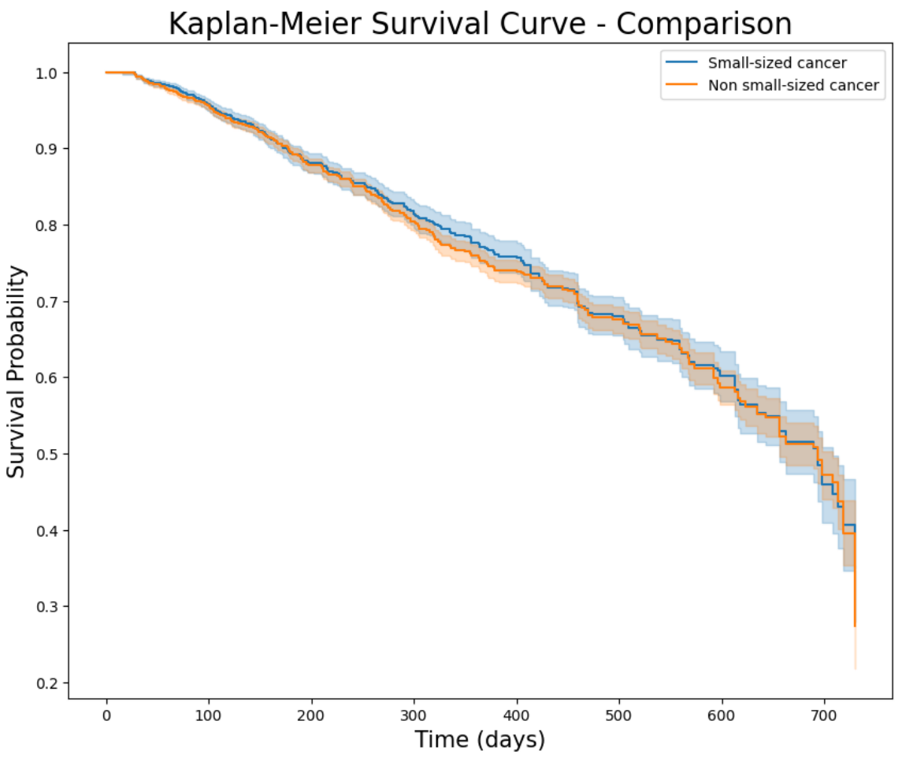
Survival rate
According to the diagnostic criteria,
non cancer
small-sized cancer
cancer
non small-sized cancer
log-rank test : p > .05 (p = 0.44)
=> size of cancer is no related to survival rate

Slide 14
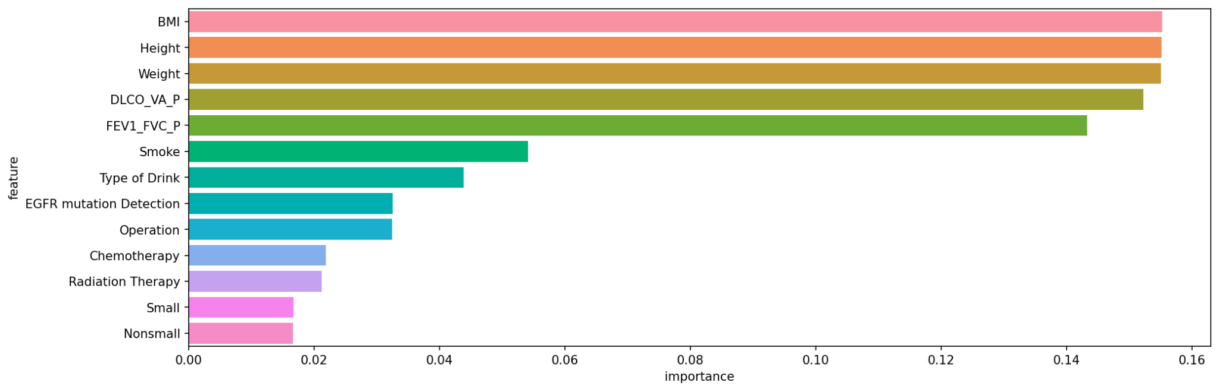
Each Treatment - Feature Importance

